Slide 1
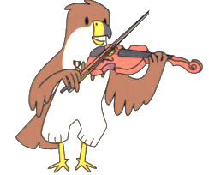
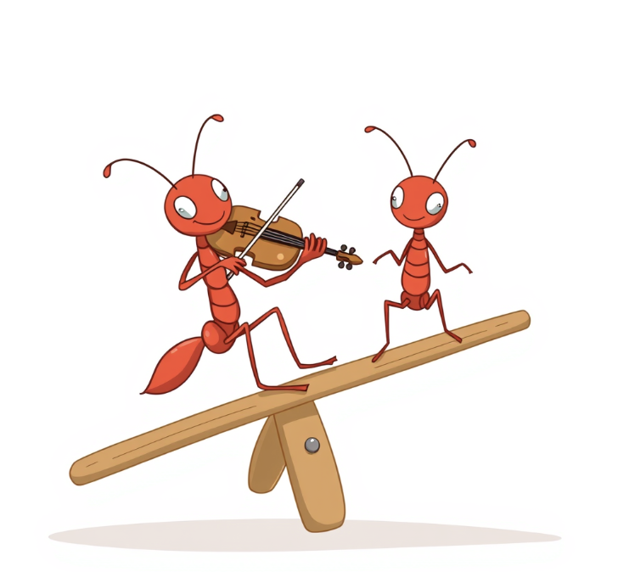
Naubuc Soaring Strings
WEEKLY Practice Record
ALL Instruments - Week 8 - 4th Grade
Directions: Practice each assignment 5 times each week. Place a check mark in the box each day you complete your practice assignment. Make sure parent/guardian at home signs, and then turn in at your next lesson.
Assignment | S | M | T | W | Th | F | S
Ant Song (Review) Play the Ant Song with your bow. Use your “Seesaws” to help play on one string at a time.
Essential Elements Page 6 and 7
Practice page 6 and 7 in your Essential Elements book pizzicato (plucking).
Use the video “Adding Fingers to the Strings” on www.naubucstrings.com and the code at the top of page 6 to help!
Mary Had a Little Lamb (Green Belt Song)
Can you learn Mary Had a Little Lamb (on the back of this practice record). This is our Green Belt Song!
Your Name:_____________________ Parent/Guardian Signature:_______________

Slide 2
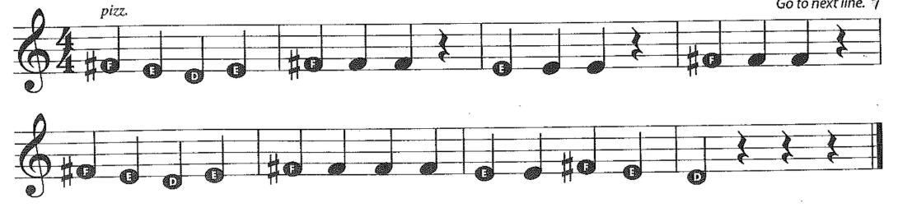
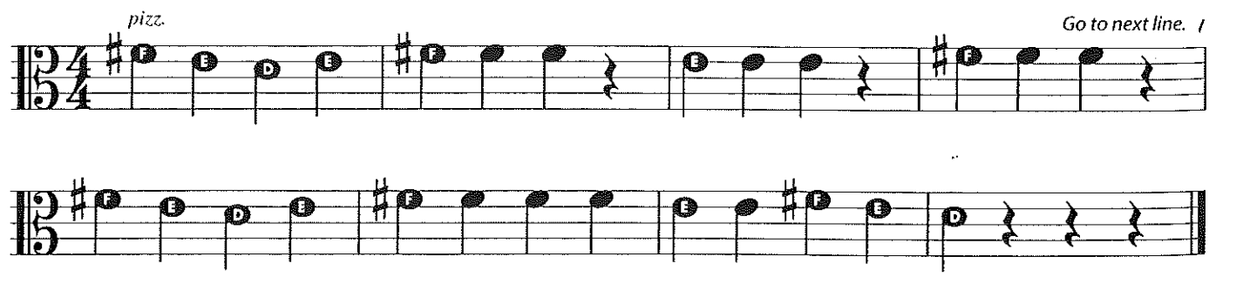
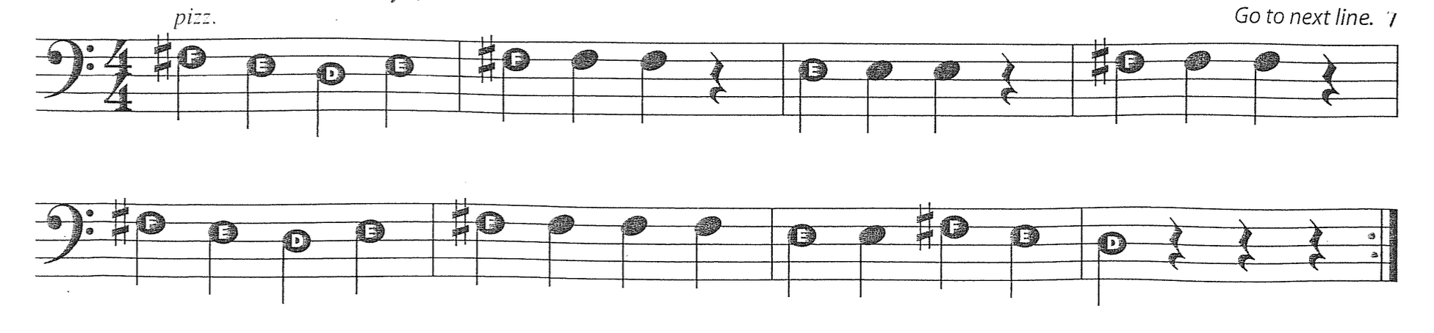
Mary Had a Little Lamb - VIOLIN
Mary Had a Little Lamb - VIOLA
Mary Had a Little Lamb – CELLO and BASS

